Slide 1






ASP.NET Web Forms Course Overview
Course Content, Evaluation, Exams
ASP.NET Web Forms
Telerik Software Academy
http://academy.telerik.com

Slide 2

Table of Contents
What's Coming Next in the Academy?
ASP.NET Web Forms Course Program
The Trainers Team
Exams and Evaluation
Standard Criteria
Bonuses
Resources for the Course

Slide 3

ASP.NET Web Forms
Coming To The Next Module

Slide 4

What's Coming Next?
ASP.NET Web development courses
ASP.NET Web Forms
ASP.NET Basics
Common features for Web Forms and MVC
ASP.NET MVC
Many homework assignments
Several team work projects
Several exams

Slide 5
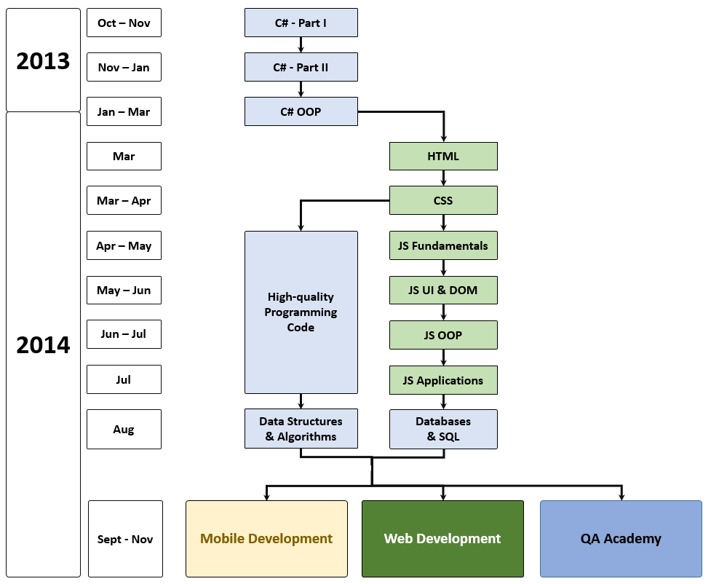
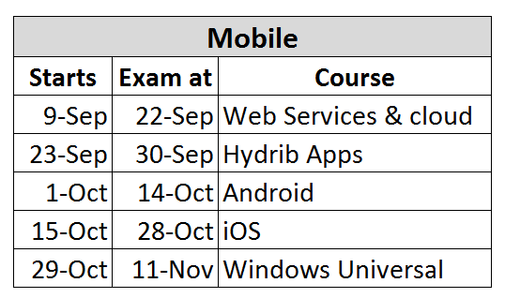
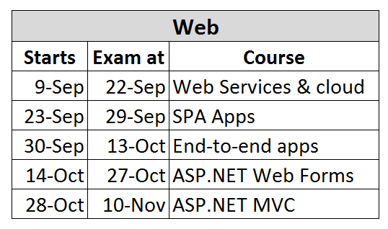
What's Coming Next?

Slide 6



ASP.NET Web Forms - Program
What Will We Cover in the Course?

Slide 7


ASP.NET Web Forms: Program
ASP.NET Intro: Web Forms, MVC, Web API, etc.
ASP.NET Web Forms Intro
Web and HTML Controls, Events
Master Pages
Data Binding and Data Controls
Data Source Controls
Scaffolding (Page Generation)
State Management and Sessions
Authentication and ASP.NET Membership

Slide 8




ASP.NET Web Forms: Program (2)
Navigation and Sitemaps
Validation Controls
ASP.NET AJAX & AJAX Control Toolkit
User Controls (.ascx)
Exam Preparation
File Upload + Kendo Upload
Caching Data
IIS Deployment
Team Work
Exam

Slide 9

The Trainers Team

Slide 10

Trainers Team
Nikolay Kostov
Team Lead, Senior Developer and Trainer @ Telerik Corp.
Student at Sofia University
Computer Science
IT and Informatics competitions contestant
Graduate from the second season of Telerik Software Academy
Email: nikolay.kostov [at] telerik.com
Blog: http://nikolay.it

Slide 11

Trainers Team (2)
Ivaylo Kenov
Technical Trainer @ Telerik Software Academy
Graduate from the fourth season of Telerik Software Academy
Mathematical competitions contestant
E-mail: ivaylo.kenov [at] telerik.com
Champion in OOP and DSA
http://ivaylo.bgcoder.com

Slide 12

Trainers Team (3)
Evlogi Hristov
Technical Trainer @ Telerik Software Academy
Graduate from the fourth season of Telerik Software Academy
E-mail: evlogi.hristov [at] telerik.com

Slide 13





Evaluation
Thank God There Are Bonuses!

Slide 14

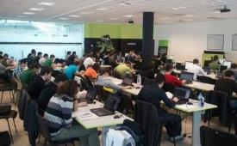
ASP.NET Web Forms – Evaluation
Evaluation
Practical exam – 60%
Peer review (at least 8)
Teamwork – 15%
Homework – 10%
Homework evaluation – 5%
3 peer reviews per homework (excellent, OK, bad)
Attendance in class – 10%
Bonuses
Forums activity – bonus up to 5%

Slide 15


Pass / Excellence / Fail Criteria
Criteria for pass / pass with excellence / fail
Pass with excellence
Very high exam results
or
High total results
Pass
Average total results
Fail
Low total results or low exam results

Slide 16
Homework Peer Reviews
Everyone will get feedback for their homework
Everyone will give feedback for few random homework submissions
Students submit homework anonymously
Please exclude your name from the submissions!
For each homework submitted
Students evaluate 3 random homeworks
From the same topic, after the deadline
Homework comments are not obligatory

Slide 17
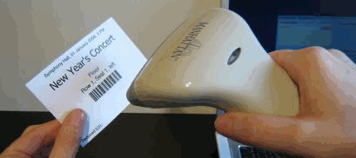
Check Your Presence
You should check your presence on the barcode reader 2 times a day:
In the morning when lectures begin (~10:30)
After lunch break (~13:30)

Slide 18








Resources
What We Need in Addition to this Course Content?

Slide 19

Course Web Site & Forums
Register for the "Telerik Academy Forums":
Discuss the course exercises with your colleagues
Find solutions for the exercises
Share source code / discuss ideas
The course official web site:
http://forums.academy.telerik.com/web-development/asp-net-web-forms
http://academy.telerik.com/student-courses/software-technologies/asp.net-web-forms/

Slide 20
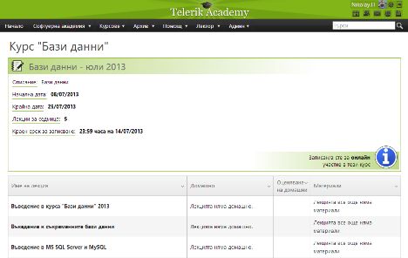
Telerik Integrated Learning System (TILS)
The Telerik Integrated Learning System (TILS)
www.telerikacademy.com
Important resource for all students
Homework submissions
Homework peer reviews
Presence cards with barcode
Reports about your results
telerikacademy.com/Courses/Courses/Details/197

Slide 21




Required Software
Software needed for this course:
Microsoft Visual Studio 2013 (with updates)
ASP.NET Web Frameworks and Tools 2013
Internet Information Services (IIS) 8.0
Microsoft SQL Server 2012

Slide 22


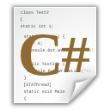


ASP.NET Web Forms Course Overview
http://academy.telerik.com

Slide 23




Free Trainings @ Telerik Academy
C# Programming @ Telerik Academy
csharpfundamentals.telerik.com
Telerik Software Academy
academy.telerik.com
Telerik Academy @ Facebook
facebook.com/TelerikAcademy
Telerik Software Academy Forums
forums.academy.telerik.com

